Slide 1

Good Morning!

Slide 2
Importance of Documentation

Slide 3


What should I document?

Slide 4
Lack of documentation leads to…
Weak Management Practices
Schedule Slippage
Unachievable Commitments
Practitioners resist Discipline
Adhoc Processes
Unpredictable Results

Slide 5
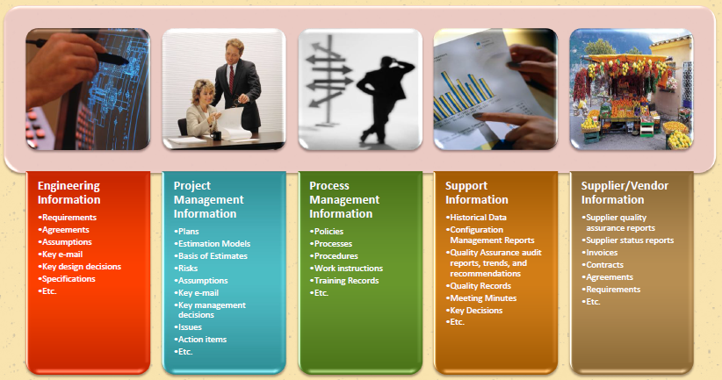
Categories of Information

Slide 6

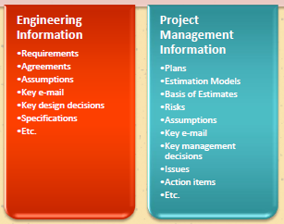
Categories of Information

Slide 7
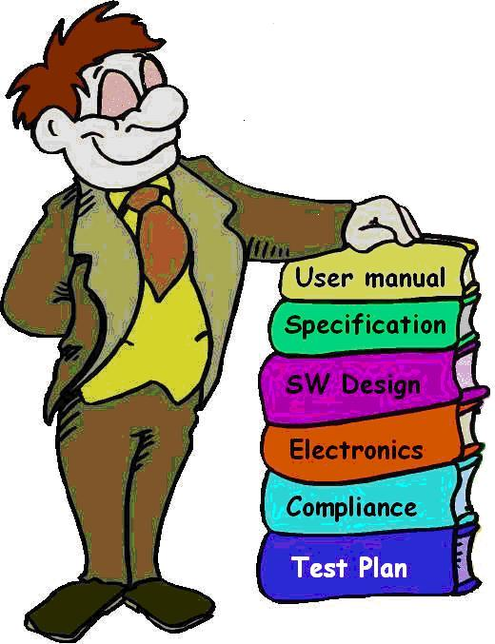
Documentation in Software Engineering

Slide 8

We don’t believe in this!

Slide 9
We believe in Being Agile!

Slide 10
Working Software over comprehensive Documentation

Slide 11
Agile does not recommend no or low documentation but places a lot of emphasis on the Right Documentation

Slide 12
Types of Documentation
Documents needed for all team members to work on the project.
Documentation to be shipped with the final product.

Slide 13
Types of Documentation
Requirements Documentation
Architecture/Design Documentation
Technical Documentation
User Documentation
Project Management Documents

Slide 14

Requirements Documentation
Focus on What is required without constraining how this will be done.

Slide 15
Sample User Story
As a … (role or actor) (Who)
I want … (what capability or feature do they need) (What)
so that … (why is it of business value or benefit) (Why)
E.g.: As a student, I want to login to my library management system so that I can renew my book.

Slide 16
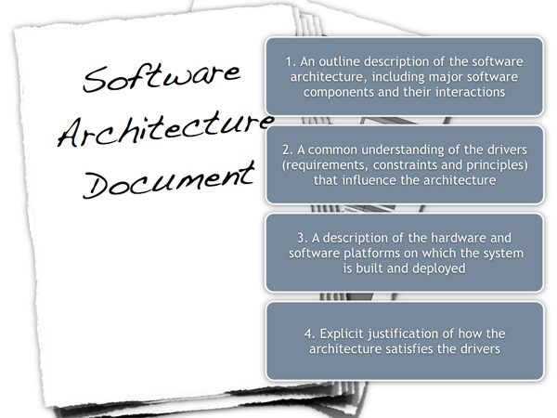
Architecture/Design Documentation

Slide 17
Technical Documentation
Design Details
Implementation Details
Deployment Details

Slide 18

Testing Documentation
Test Plan
Test Scripts
Test Cases
RTM
Test Report

Slide 19
User Documentation
User Manual
Release Notes

Slide 20
Project Management Documentation
Project Proposal and Scope
Project Plan
Resource Plan
Risk Plan
Quality Assurance Plan

Slide 21

Why is Documentation Extremely Important for Developers?

Slide 22

1. It keeps you on track

Slide 23

2. You don’t have to be mind readers!

Slide 24

3. Everyone in your organization will be pointed in the same direction

Slide 25

4. Reduced training time

Slide 26
And Finally…..

Slide 27

Documentation signals that you are a Professional …

Slide 28

Question Time?

